Slide 1
AN IoT BASED AUTOMATION TECHNIQUE FOR SMART AGRICULTURE
Done by:-
V. R. Krishna Srujan
K. Prudvi Raj Rathod
Ramidi Prashanth Reddy
Under the supervision of
Dr. S. Praveen Chakkravarthy
Associate professor

Slide 2
Motivation
Poor agricultural practice is one of the biggest problems in India.
Poor seed quality, poor monitoring of plant growth, lack of cold storage and harvest spoilage cause over 30% of farmer's produce going to waste.
Farmer cannot fix price for his product.
Excessive usage of fertilisers will harm the life giving quality of the land and reduces the natural ability of the earth to feed and clothe humankind.
According to the MHRD survey over 12000 suicides were reported in agricultural sector every year since 2013.

Slide 3
ABSTRACT
Unified platform
Bridging farmers and end consumers
Green IoT ecosystem

Slide 4
OBJECTIVE
To create a unified platform and create awareness among the farmers towards raising the agricultural standards throughout the country which will definitely reflect in economical growth.
A Green IoT based ecosystem is the solution to
Efficient farming
A Novel e-Marketing technique
Total production and Total development throughout the country

Slide 5
Introduction
The work focus on monitoring the growth stages of potato (a tuber)
Involvement of different sensors , database creation, Interpretation and bridging farmer and consumer.

Slide 6
Literature survey for potato specimen
Scientific name- Solanum tuberosum.
Temperature and humidity -(22-26)Degree C at 50%-75% RH.
pH of soil-(5.2-6.4).
Drip irrigation is suitable. It saves 50% water.
Plant releases ethylene gas. The air quality changes.
Leaves turn yellow at the end of growing season.

Slide 7
Importance of Potato
Potato is consumed by more than one billion people the world over.
Used in preparing more than 100 types of recipes in India.
Potato can be supplement of meat and milk reducing food cost.
Potato is a wholesome food and a potential high quality vegetable cum food crop in the country.
Dr. Mahabal Ram(Author)
Potato crop is a heavy feeder and hence needs heavy doses of fertilizers for its good growth.
Great need to use organic sources of manures.
Ventilated room to prevent excess humidity and to introduce oxygen.
The storage room should be dark as light causes greening .
LITERATURE SURVEY

Slide 8
Common potato diseases
Early Blight Early blight is a fungus characterized by dark brown spots that take over the leaves, eventually killing them. It is most common in warm, wet environments.
Mosaic Virus Mosaic virus causes potato leaves to curl with shades of light green and dark green at the same time. Spread by aphids, most outbreaks won’t destroy plants but will reduce yields. Keep aphids under control with insecticidal spray.
Potato Scab Potato scab is a soil borne bacterium. It causes scabby spots to appear on the tubers. Slightly acidic soil (4.8 – 5.2) helps reduce the risk of this disease. Scab is usually just a cosmetic problem and tubers can still be harvested.

Slide 9
ADDRESSED PROBLEMS
Due to lack of awareness about farming techniques, most of the farmers adapt to traditional farming practices which may lead to infertility, reduced nutritional values and their farm produce becomes waste.
Post produce goods are stored till suitable buyer is available, this will lead to wastage of goods.
The farmers depend on prices fixed by market.
Presence of farmers on farming land to observe the status/progress of the farm.

Slide 10
PROPOSED WORK
The idea focus on raising the standard of agriculture with the motto “Total production and Total development across the nation". The product will monitor the status of the farm and help improvising the production by suggesting the use of required fertilizers and pesticides.
Arduino Uno Microcontroller used in the hardware will gather and interpret the data from following sensors
TCS 230 color sensor
YL 69 soil moisture sensor
DHT 11 temperature and humidity module
MQ 135 gas sensor
GSM shield
Status of the farm is sent to farmer’s mobile phone through GSM.
An application is developed to bridge the gap between consumer and farmer.

Slide 11
BLOCK DIAGRAM
TCS230
Arduino Uno
GSM shield
Farmer
Crop/plant
DHT11
APP
Database
MQ135
YL - 69
Consumer

Slide 12
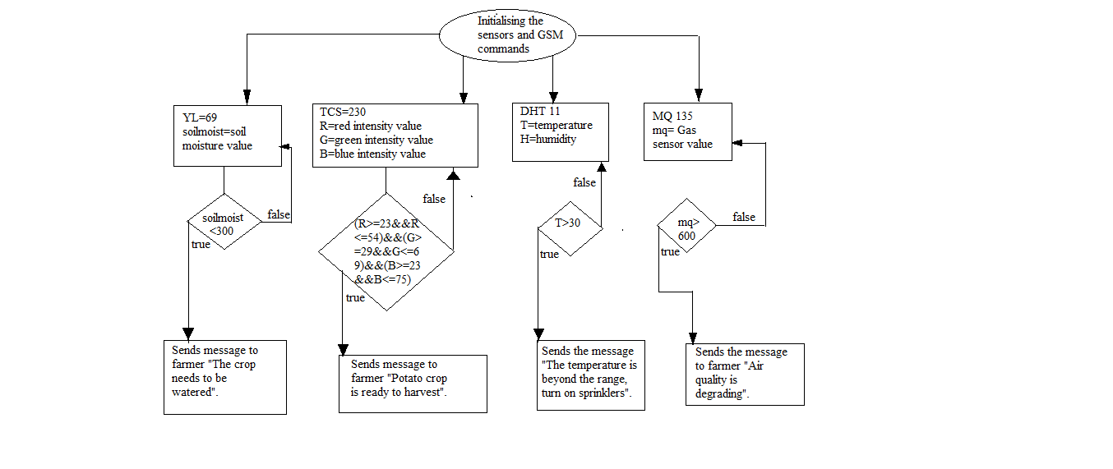
Flowchart

Slide 13
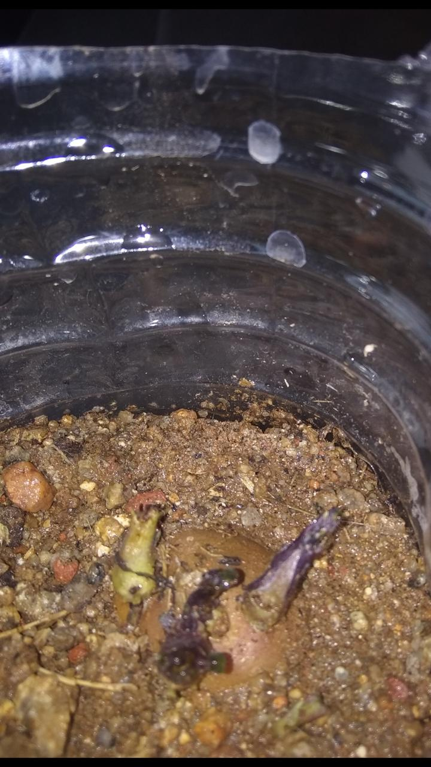
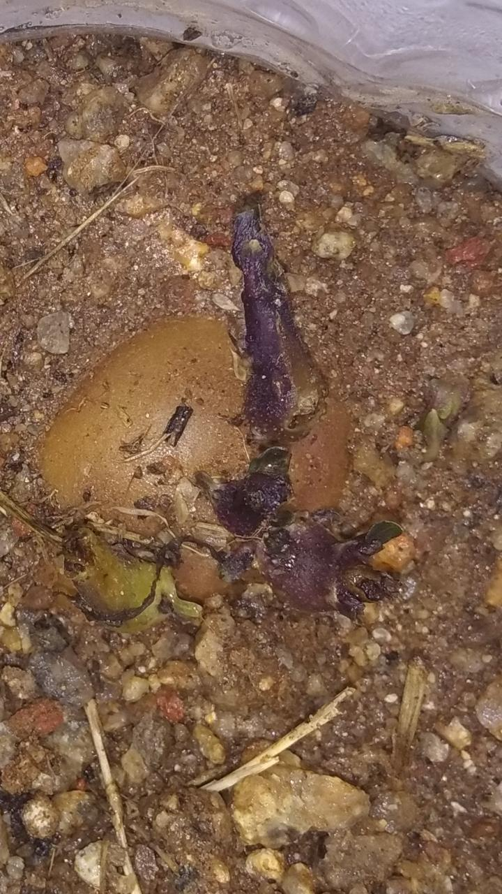
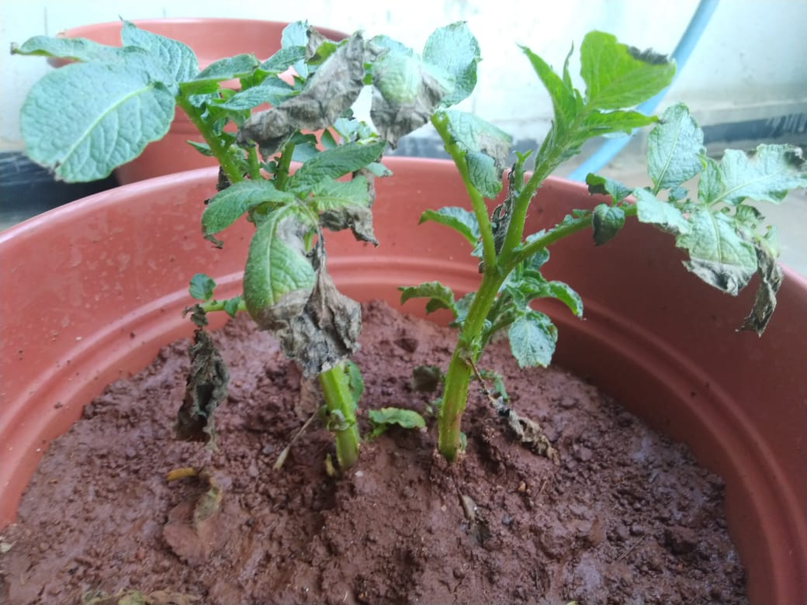
Growth process of the plant
Date of planting: 02-01-2019
5th day
9th day
33rd day

Slide 14
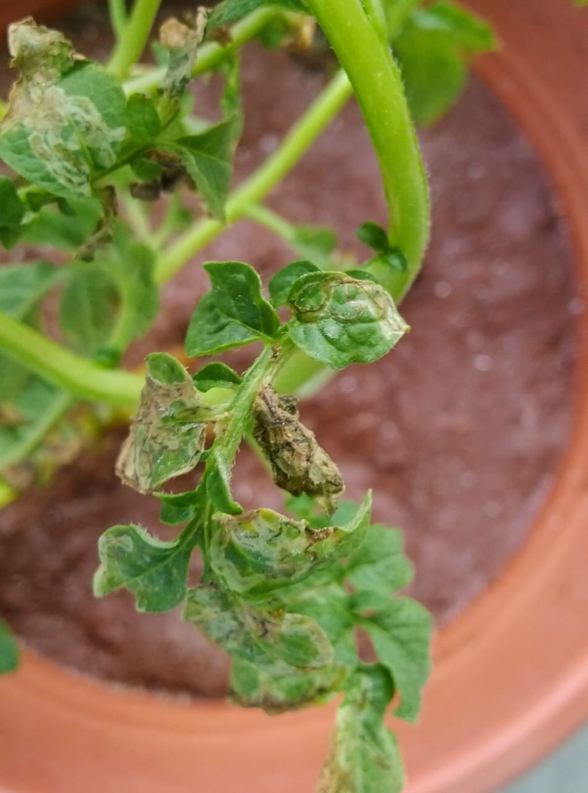
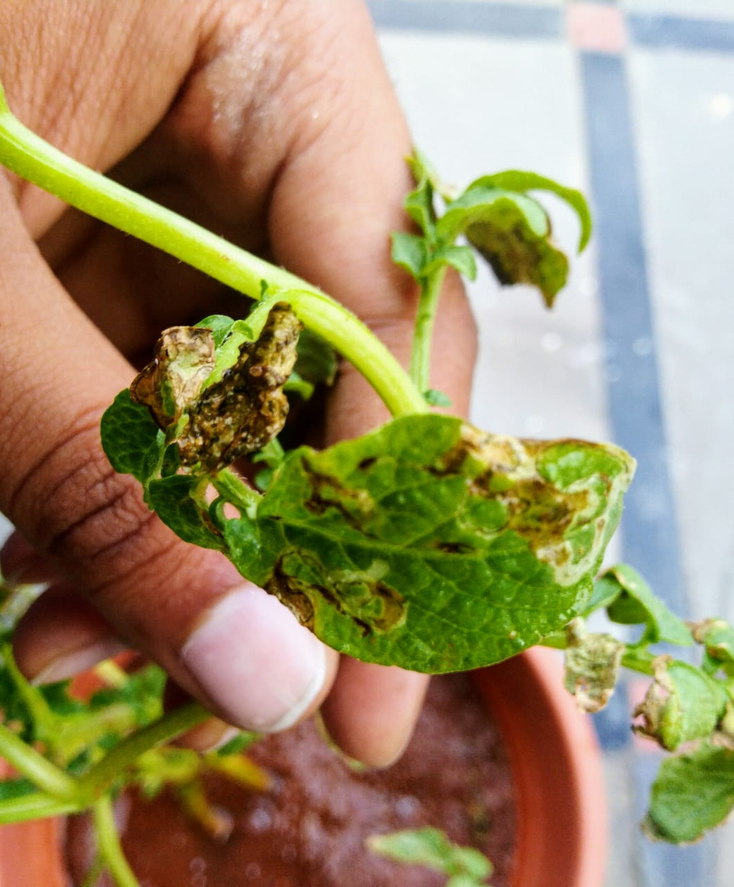
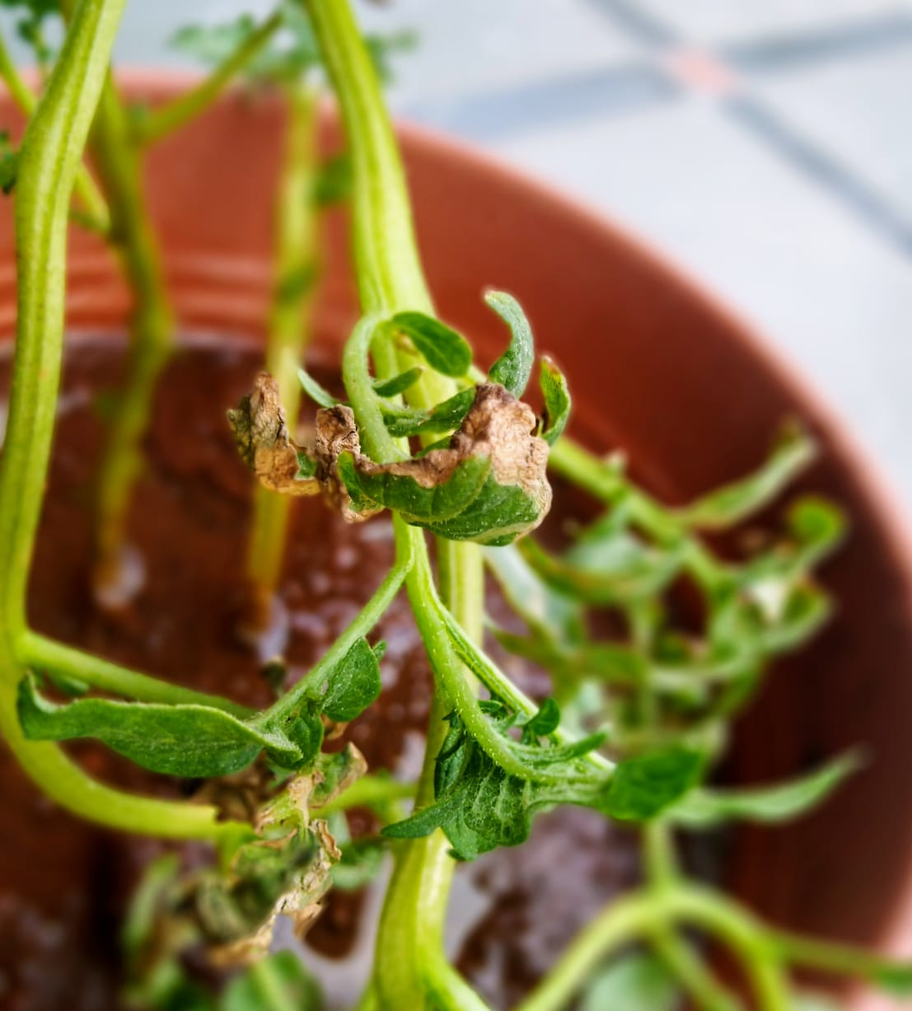
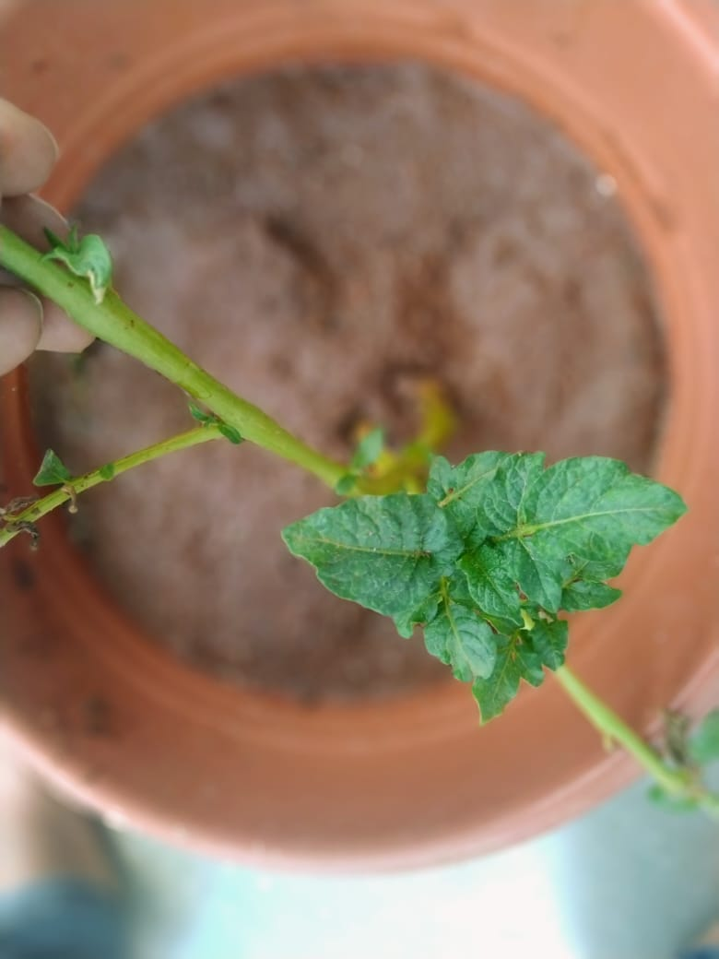
Alterania Solani
Fungal Disease
Old leaves 45th Day
New leaves
60th Day

Slide 15
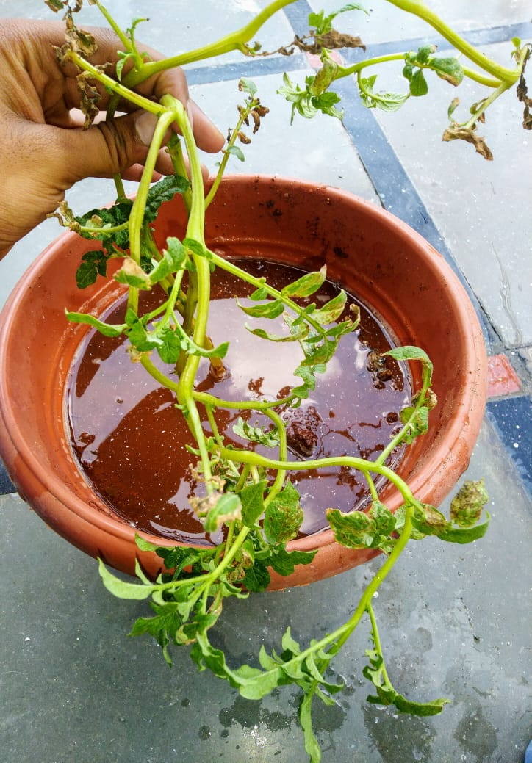
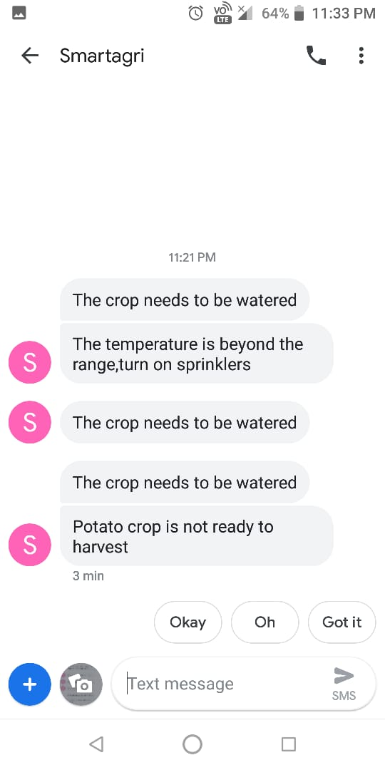
Text messages sent to Mobile Phone from
GSM Shield
69th Day

Slide 16
Software
THUNKABLE CLASSIC ANDROID APP DEVELOPER
Drag and drop
Queries
FIREBASE DB
Real time database
Image storage
Private and public

Slide 17

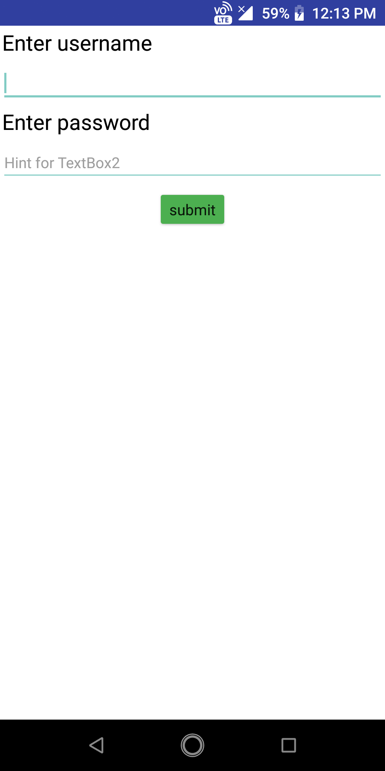
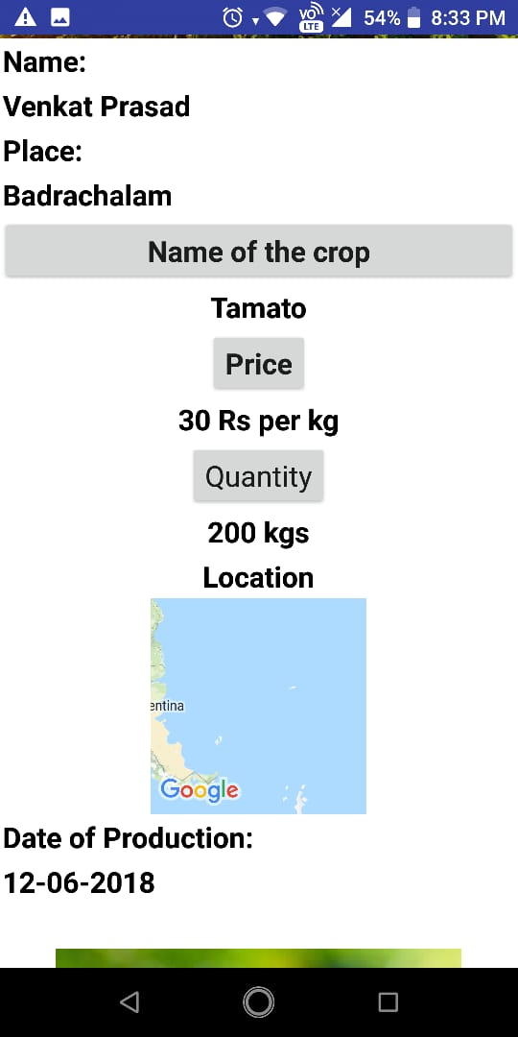
APPLICATION
Screen 1:
Screen 2:
Screen 3:

Slide 18
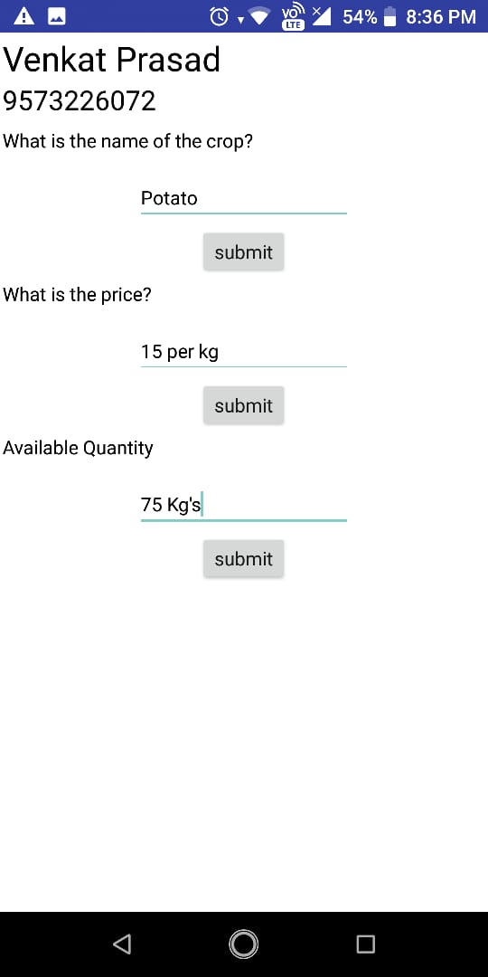
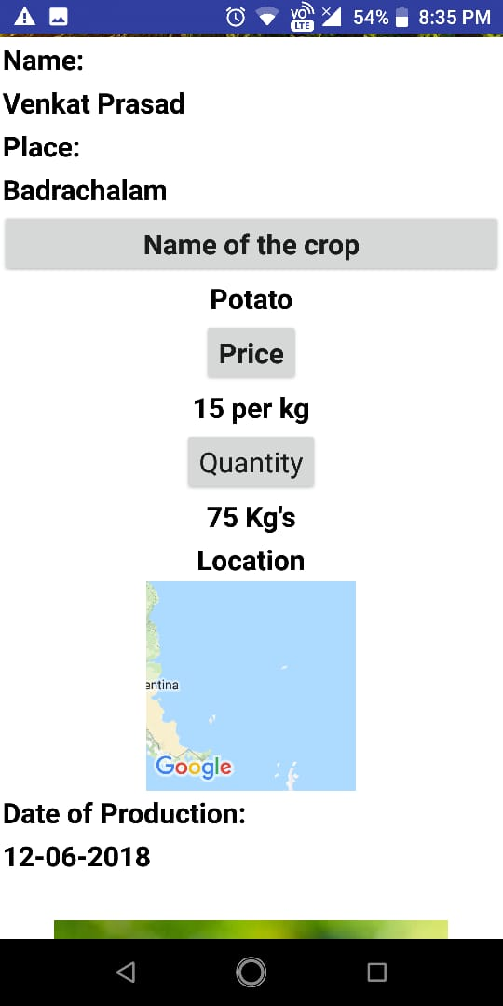
Screen 4:
Screen 5:

Slide 19
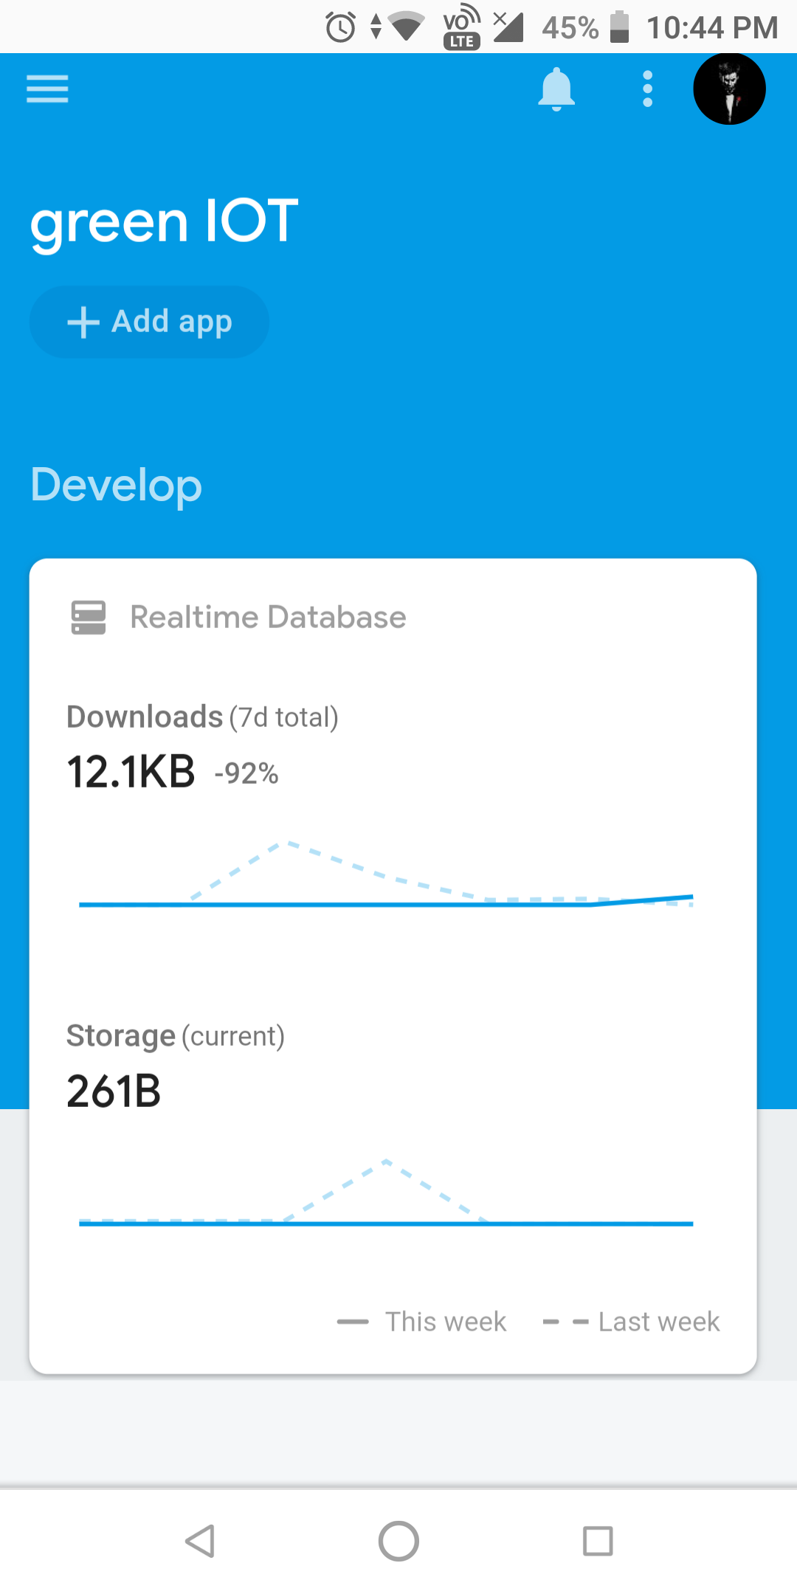
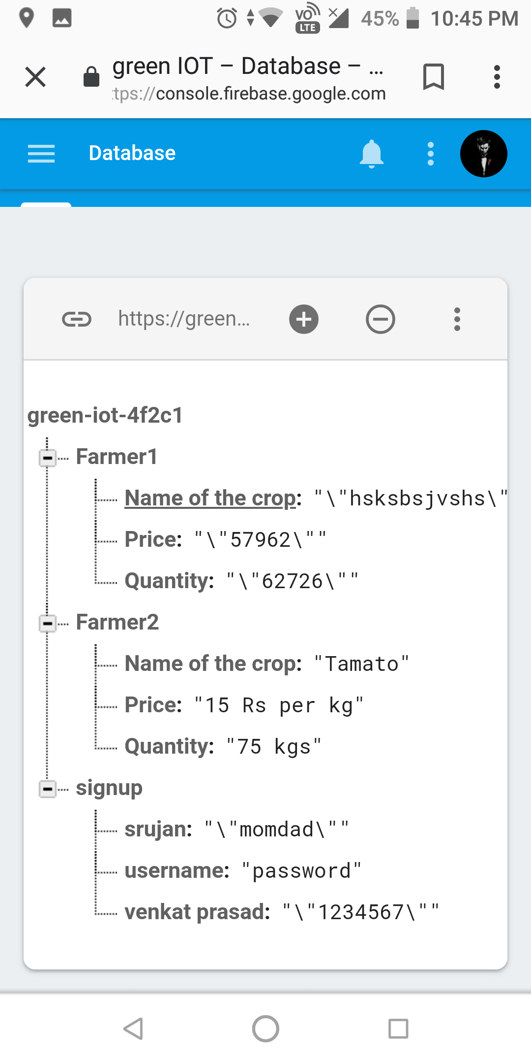
Firebase DB

Slide 20
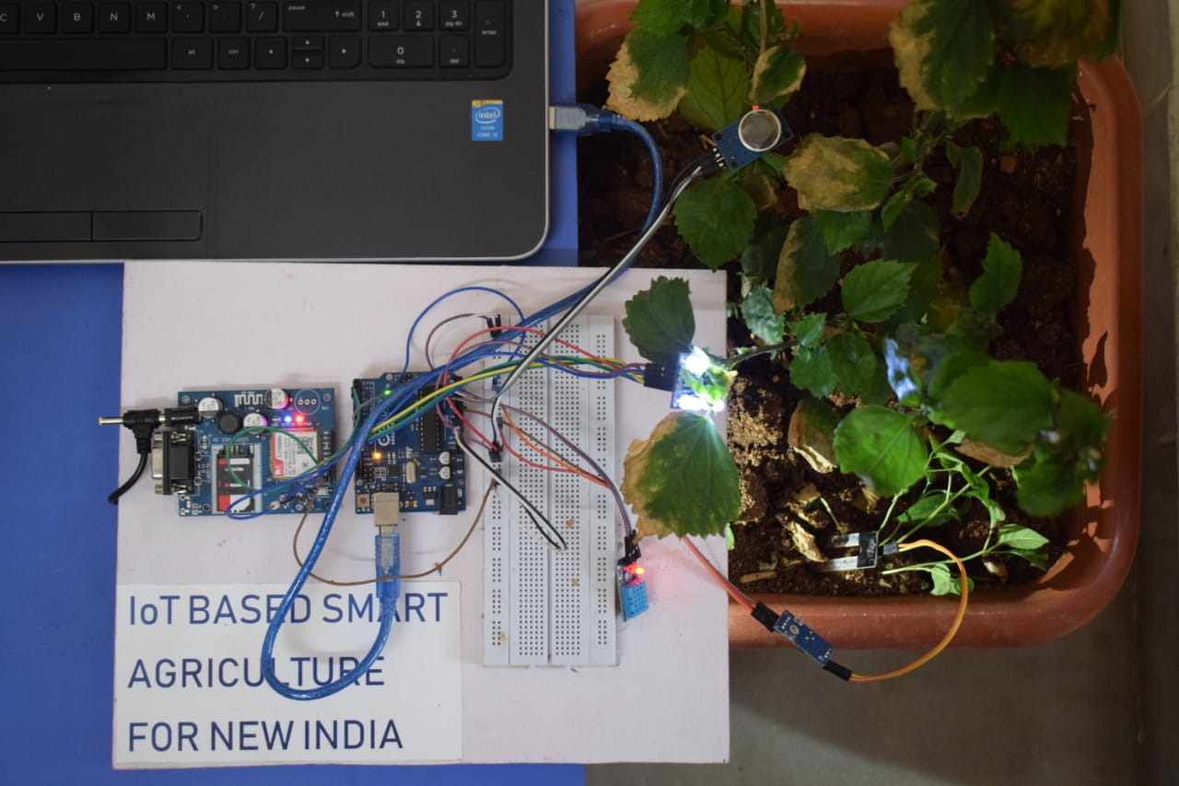
Product under working condition

Slide 21

CONCLUSION
Direct To Farm (DTF) culture for Indian agriculture.
A platform to inspire research in Agricultural sector.
An attempt to unlock real world problems of farmers in India.
Technology to assist the industry which has more than 130 crores of customers in India.
A promising technology to cater the needs of farmers and government
A dream for USD 5 Trillion dollar economy of the country will certainly become the reality.

Slide 22

FUTURE SCOPE FOR RESEARCH
Implementation in farm.
Introduction to bio communication in the country.
A cost effective and efficient method to analyze the quantity of vegetable or fruit.

Slide 23
Thank You

